Slide 1


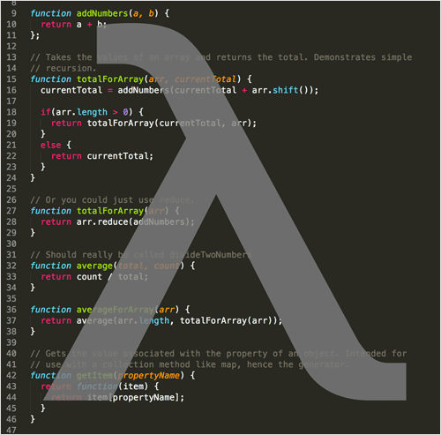

Stream API, Error handling
Working with the Stream API,
(try/catch/finally), Checked / Unchecked Exceptions
Java
Fundamentals
SoftUni Team
SoftUni Team
Technical Trainers
Technical Trainers
Software University
Software University
http://softuni.bg

Slide 2

Table of Contents
Stream<T> Class
Types of Streams in Stream API
Generic, Primitive
Types of Stream Operations
Intermediate, Terminal
Map, Filter, Reduce
Collectors
Streams on Maps
Error handling try/catch/finally
Checked / Unchecked Exceptions

Slide 3
Questions
sli.do #db-advanced

Slide 4
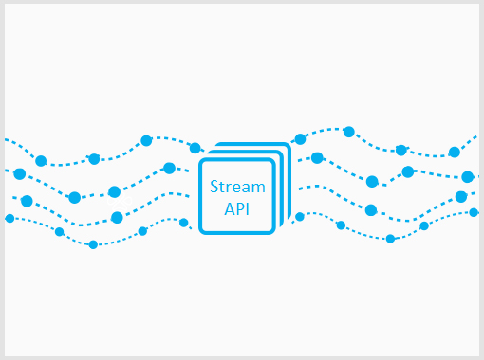

Stream API
Traversing and Querying Collections

Slide 5
The Stream API
Querying a collection in a functional way
Methods are chained together
Example:
Find all unique elements, such that 10 ≤ n ≤ 20 and take the first 2
15
2
15
14
12
15
14

Slide 6
Problem: Take Two
Create a program that:
Reads a sequence of integers
Finds all unique elements, such that 10 ≤ n ≤ 20
Prints only the first 2 elements
15 2 15 14 12
15 14
17 -2 3
17
-2 3
(no output)
Check your solution here: https://judge.softuni.bg/Contests/Practice/Index/465#0

Slide 7
Solution: Take Two – Non Functional
LinkedHashSet<Integer> set = // create set
for (Integer number : numbers) {
if (set.size() >= 2) {
break;
}
if (10 <= number && number <= 20) {
set.add(number);
}}
Check your solution here: https://judge.softuni.bg/Contests/Practice/Index/465#0

Slide 8
Solution: Take Two – Functional
numbers.stream()
.filter(n -> 10 <= n && n <= 20)
.distinct()
.limit(2)
.forEach(n -> print(n));
Check your solution here: https://judge.softuni.bg/Contests/Practice/Index/465#0

Slide 9
Stream<T> Class
Gives access to Stream API functions.
Get an instance through:
A Collection:
An Array:
List<Integer> list = new ArrayList<>();
Stream<Integer> stream = list.stream();
String[] array = new String[10];
Stream<String> stream = Arrays.stream(array);

Slide 10
Stream<T> Class (2)
Gives access to the Stream API.
Get an instance through:
A Hash Map Collection:
HashMap<String, String> map = new HashMap<>();
Stream<Map.Entry<String, String>> entries = map.entrySet().stream();
Stream<String> keys = map.keySet().stream();
Stream<String> keys = map.values().stream();

Slide 11
Function Execution
Each function call creates a new Stream<T> instance
This allows method chaining
List<String> strings = new ArrayList<>();
Stream<String> stringStream = strings.stream();
Stream<Integer> intStream = stringStream.map(s -> s.length());

Slide 12
Function Execution (2)
Execution is "Lazy"
List<Integer>
10
2
5
2
stream()
10
2
5
2
filter(x -> x > 4)
10
2
5
2
map(x -> x * 2)
20
10
forEach(print(x))
20
10

Slide 13

So What is a Stream?
Stream is not a collection and don't store any data
Stream iterates over a collection
Does not modify data it processes
2
5
10
2
5
10

Slide 14

Stream Types and Optionals
Generic and Primitive Streams

Slide 15
Generic Streams
Can be of any type except primitives
List<String> strings = new ArrayList<>();
Stream<String> strStream = strings.stream();
List<Integer> ints = new ArrayList<>();
Stream<Integer> intStream = ints.stream();
List<Object> objects = new ArrayList<>();
Stream<Object> objStream = objects.stream();

Slide 16
Problem: UPPER STRINGS
Read a sequence of strings
Map each to upper case and print them
Use the Stream API
Pesho Gosho Stefan
PESHO GOSHO STEFAN
Soft Uni Rocks
SOFT UNI ROCKS
Check your solution here: https://judge.softuni.bg/Contests/Practice/Index/465#0

Slide 17
Solution: UPPER STRINGS
Scanner scanner = new Scanner(System.in);
List<String> strings = Arrays.asList( scanner
.nextLine()
.split("\\s+"));
strings.stream()
.map(s -> s.toUpperCase())
.forEach(s -> System.out.print(s + " "));
Check your solution here: https://judge.softuni.bg/Contests/Practice/Index/465#0

Slide 18
Optional<T>
Some functions can return Optional<T>
Optional<String> first = elements.stream()
.sorted()
.findFirst();
if (first.isPresent()) {
System.out.println(first.get());
else
System.out.println("No matches.");
Check if optional has value
Gets the value

Slide 19
Problem: First Name
Read a sequence of names
Read a letter
Of the names that start with the letter find the first name by lexicographical order
Rado Plamen Pesho
p
Pesho
Plamen Gosho Rado
s
No match

Slide 20
Solution: First Name
Scanner scanner = new Scanner(System.in);
List<String> names Arrays.asList(scanner.nextLine() .split("\\s+"));
Character ch = scanner.nextLine().toLowerCase().charAt(0);
Optional<String> first = names.stream()
.filter(name -> name.toLowerCase().charAt(0) == ch).sorted().findFirst();
if (first.isPresent())
System.out.println(first.get());
else
System.out.println("No match");

Slide 21
Primitive Streams
Work efficiently with primitive types
Give access to additional functions
int[] ints = { 1, 2, 3, 4 };
IntStream intStream = IntStream.of(ints);
List<Integer> list = new ArrayList<>();
IntStream mappedIntStream = list.stream()
.mapToInt(n -> Integer.valueOf(n));

Slide 22
Problem: Average of Doubles
Read a sequence of double numbers
Find the average of all elements
Use the Stream API
Round to second digit
3 4 5 6
4.50
3.14 5.2 6.18
4.84
(empty sequenece)
No match
Check your solution here: https://judge.softuni.bg/Contests/Practice/Index/465#0

Slide 23
Solution: Average of Doubles
OptionalDouble average = elements.stream()
.fiter(n -> !n.isEmpty())
.mapToDouble(Double::valueOf)
.average();
if (average.isPresent())
System.out.printf( "%.2f", average.getAsDouble());
else
System.out.println("No match");
Gets the value
Check your solution here: https://judge.softuni.bg/Contests/Practice/Index/465#0

Slide 24


Types of Operations
Intermediate, Terminal

Slide 25
Intermediate Operations
Does not terminate the Stream
List<String> elements = new ArrayList<>();
Collections.addAll(elements, "one", "two");
Stream<String> stream = elements.stream()
.distinct()
.sorted()
.filter(s -> s.length() < 5)
.skip(1)
.limit(1);
All return a new Stream
Allows function chaining

Slide 26
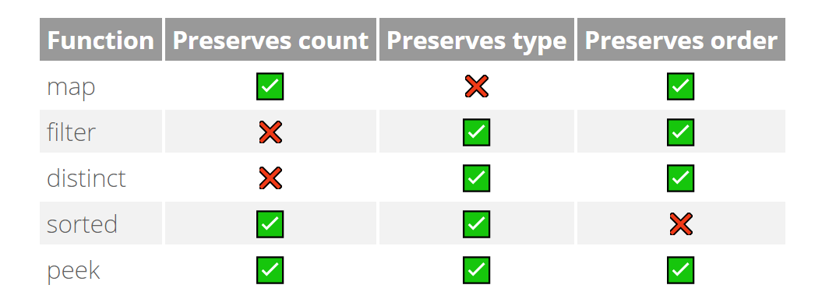
Intermediate Operations (2)
Some of the intermediate operations

Slide 27
Terminal Operations
Terminates the stream
List<String> elements = new ArrayList<>();
Collections.addAll(elements, "one", "two");
elements.stream()
.distinct()
.forEach(s -> System.out.println(s))
Closes the stream

Slide 28
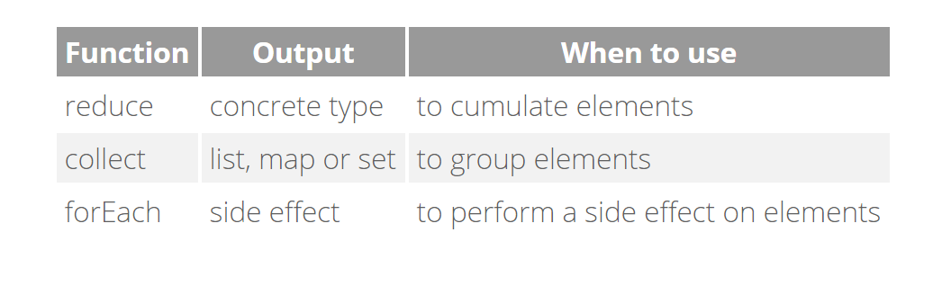
Terminal Operations (2)
Useful terminal operations:

Slide 29

Types of Operations
Map, Filter, Reduce

Slide 30
Map, Filter, Reduce
Common pattern in data querying
List<String>
"10"
"2"
"5"
"6"
.mapToInt(Integer::valueOf())
10
2
5
6
.filter(x -> x > 4)
10
5
6
10
5
6
21
.reduce((x, y) -> x + y)
15

Slide 31
Map Operations
Transform the objects in the stream
Stream<String> strStream =
Stream.of("1", "2", "3");
Stream<Integer> numStream = strStream.map(Integer::valueOf);
Transforms the stream

Slide 32
Filter Operations
Filters objects by a given predicate
Stream<String> strStream = Stream.of("one", "two", "three")
.filter(s -> s.length() > 3);
Preserves strings longer that 3

Slide 33
Reduce Operations
Check for a given condition:
Any element matches:
All elements match:
None of the elements match:
Short circuit operations
Short circuit operations
boolean any = stream1.anyMatch(x -> x % 2 == 0);
boolean all = stream2.allMatch(x -> x % 2 == 0);
boolean none = stream3.noneMatch(x -> x % 2 == 0);

Slide 34
Find Reductions
Find an element:
Gets the first element of the stream:
Gets any element of the stream:
Optional<Integer> first = list.stream() .findFirst();
Optional<Integer> first = list.stream() .findAny();

Slide 35
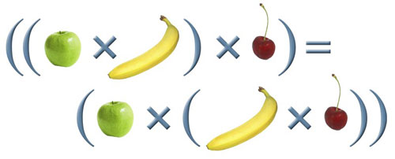
General Reduction
Applies а given lambda:
Consider associativity:
Optional<Integer> first = list.stream() .reduce((x, y) -> x + y);
r(a, r(b, c)) should be equal to r(r(a, b), c)

Slide 36
Problem: Min Even Number
Read a sequence of numbers
Find the min of all even numbers
Use the Stream API
1 2 3 4 5 6
2.00
3.14 -2.00 1.33
-2.00
(empty list)
No match
Check your solution here: https://judge.softuni.bg/Contests/Practice/Index/465#0

Slide 37
Solution: Min Even Number
Optional<Double> min = Arrays.stream( scanner.nextLine().split("\\s+"))
.filter(n -> !n.isEmpty())
.map(Double::valueOf)
.filter(n -> n % 2 == 0)
.min(Double::compare);
Check your solution here: https://judge.softuni.bg/Contests/Practice/Index/465#0

Slide 38
Problem: Find and Sum Integers
Read a sequence of elements
Find the sum of all integers
Use the Stream API
Sum 3 and 4
7
Sum -3 and -4
-7
Sum three and four
No match
Check your solution here: https://judge.softuni.bg/Contests/Practice/Index/465#0

Slide 39
Solution: Find and Sum Integers
Optional<Integer> sumOfIntsGT20 = Arrays.stream( scanner.nextLine().split("\\s+"))
.filter(x -> isNumber(x))
.map(Integer::valueOf)
.reduce((x1, x2) -> x1 + x2);
Implement boolean method
Check your solution here: https://judge.softuni.bg/Contests/Practice/Index/465#0

Slide 40
Sorting
Sort by passing a comparator as lambda:
List<Integer> numbers = new ArrayList<>();
Collections.addAll(numbers, 7, 6, 3, 4, 5);
numbers.stream()
.sorted((x1, x2) -> Integer.compare(x1, x2)) .forEach(System.out::println);
(x2, x1) for descending order

Slide 41





Collectors
Materializing a Stream

Slide 42

Collectors
Collecting a Stream into a list:
You can collect streams into different collections:
Arrays, Set, Map, etc.
String[] strings = { "22", "11", "13" };
List<Integer> numbers = Arrays.stream(strings)
.map(Integer::valueOf)
.collect(Collectors.toList());

Slide 43
Problem: Bounded Numbers
Read a lower and upper bound
Read a sequence of numbers
Print all numbers, such that lower bound ≤ n ≤ upper bound
5 7
1 2 3 4 5 6 7 8 9
7 5
9 5 7 2 6 8
5 6 7
5 7 6
Check your solution here: https://judge.softuni.bg/Contests/Practice/Index/465#0

Slide 44
Solution: Bounded Numbers
Scanner scanner = new Scanner(System.in);
List<Integer> bounds = Arrays.stream(scanner.nextLine().split("\\s+"))
.map(Integer::valueOf)
.collect(Collectors.toList());
// continues…
Check your solution here: https://judge.softuni.bg/Contests/Practice/Index/465#0

Slide 45
Solution: Bounded Numbers (2)
List<Integer> numbers = Arrays.stream(scanner.nextLine().split("\\s+"))
.map(Integer::valueOf)
.filter(x -> Collections.min(bounds) <= x && x <= Collections.max(bounds))
.collect(Collectors.toList());
Check your solution here: https://judge.softuni.bg/Contests/Practice/Index/465#0

Slide 46


Streams on Maps
Creating a Stream over a Map

Slide 47
Creating the Stream
Use any dimension of the Hash Map:
Stream over the Entry set:
Stream over the Key set:
Stream over the Value set:
Stream<Map.Entry<String, String>> entries = map.entrySet().stream();
Stream<String> keys = map.keySet().stream();
Stream<String> keys = map.values().stream();

Slide 48
Problem: Book Store
Create class Book with name, author and price fields
Create a steam of Books
For each distinct author find the sum of prices of his books
Sort result Map by decreasing sum of prices, then by author name alphabetically
Stream<Book> books = Stream.of(new Book("Vinetu3", 20, "Karl Mai"),new Book("Vinetu1", 20, "Karl Mai"),
new Book("Vinetu2", 15, "Karl Mai"),
new Book("Sherlock Holmes", 12, "Arthur C. Doyl"),
new Book(“The Lost World", 43, "Arthur C. Doyl"));
Arthur C. Doyl=55.0
Karl Mai=55.0

Slide 49
Solution: Book Store
books.collect(
Collectors.groupingBy(Book::getAuthor,
Collectors.summingDouble(Book::getPrice))
)
.entrySet()
.stream()
.sorted(Map.Entry.<String, Double>comparingByValue()
.reversed()
.thenComparing(Map.Entry.<String, Double>comparingByKey()))
.forEach(System.out::println);

Slide 50

Error Handling
Working with Exceptions

Slide 51
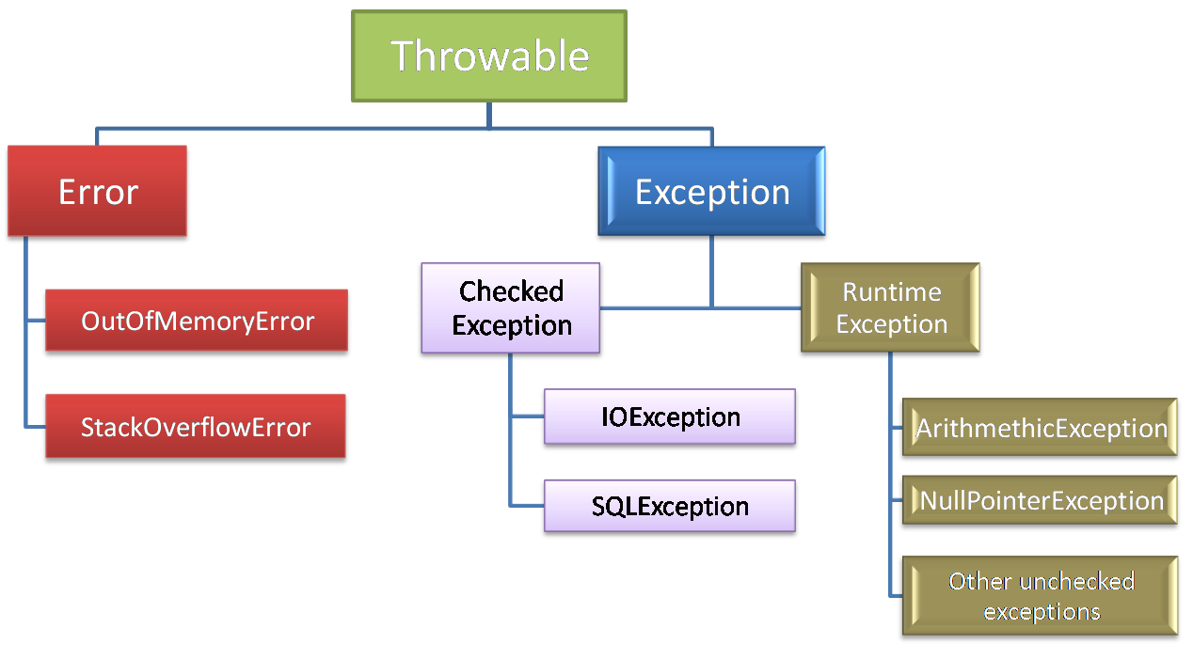
Exceptions in Java
Exceptions are objects derived from Throwable interface
Throwables are used to describe and handle failures at Runtime

Slide 52
Types of runtime failures
Recoverable - Exception
Checked by the compiler - specify in method declaration by throws clause or catch it
Unchecked exceptions derived from RuntimeException, not obliged to declare or catch
Unrecoverable - Errors
public abstract int read() throws IOException;
public class NullPointerException extends RuntimeException

Slide 53
Exceptions
Exception object is created like any other object by calling new thrown from main method
Its holding description of the failure in message
It may wrap another Throwable object which is the root cause of the failure
It provides information about place of the failure
public Exception (String message, Throwable cause)
public String getMessage()
public Throwable getCause()
public void printStackTrace()

Slide 54
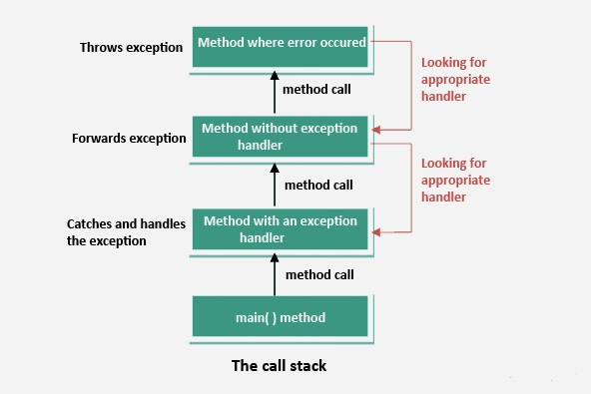
Exceptions and Call Stack
An exception is an event (object), which is thrown during the execution of a program, that disrupts the normal flow of the program's instructions
Execution goes backwards
through the call stack until
a proper handler is met
In case no handler is met
program terminates with an
exception object thrown from main method

Slide 55
Error Handling
//normal code execution which acquires some resource
try {
// use resource, exceptions possible
}
catch (SomeException e) {
//exception is caught, but what to do ???
//Should I catch it if I do
//not know how to recover from it ???
//Recover OR Report and re-throw !!!
}
finally {
//always executed, no matter if exception was
//thrown or not
//nice place to release the resource
}

Slide 56
Problem: Print File
Write a program which takes a path to a file.
The program should read the file and print its content to the console.
Make sure the program is closing all resources it uses.
Inform the user in case of file printed successfully.
Inform the user for the case of reading operation failed.

Slide 57
Solution(1): Print File
private static void printFile(String fileName) throws FileNotFoundException {
File sourceFile = new File(fileName);
Scanner = new Scanner(sourceFile);
String line = "";
try {
while (scanner.hasNext()) {
line = scanner.nextLine();
System.out.println(line);
}
} finally {
scanner.close();
}}

Slide 58
Solution(2): Print File
//initialize Scanner, isPrinted and ch variables
try {
do {
System.out.println("Enter path to the file to print : ");
String filePath = scanner.nextLine();
try {
printFile(filePath);
isPrinted = true;
} catch (FileNotFoundException e) {
System.out.println("File with name \"" + filePath
+ " \" is not found !");
System.out.println("Do you want to try again?(y or n)");
ch = scanner.next().toLowerCase().trim().charAt(0);
}} while (!isPrinted && ch == 'y');
} finally {
scanner.close();
}
//Show success message if isPrinted is true

Slide 59
Summary
Stream API is used to traverse and query collections
Streams have "lazy" execution
Streams can be Generic or Primitive
Types of Operations
Streams can be collected into a collection
Streams can operate over Map entries, keys or values.
Don’t forget to release resources, handle an exception if you can throw it otherwise.
Some exceptions are checked in compile time, others are not (unchecked)

Slide 60







Java OOP Fundamentals
https://softuni.bg/courses/databases-advanced-hibernate

Slide 61

License
This course (slides, examples, demos, videos, homework, etc.) is licensed under the "Creative Commons Attribution-NonCommercial-ShareAlike 4.0 International" license
Attribution: this work may contain portions from
"Databases" course by Telerik Academy under CC-BY-NC-SA license

Slide 62





Free Trainings @ Software University
Software University Foundation – softuni.org
Software University – High-Quality Education, Profession and Job for Software Developers
softuni.bg
Software University @ Facebook
facebook.com/SoftwareUniversity
Software University Forums
forum.softuni.bg

